Slide 1
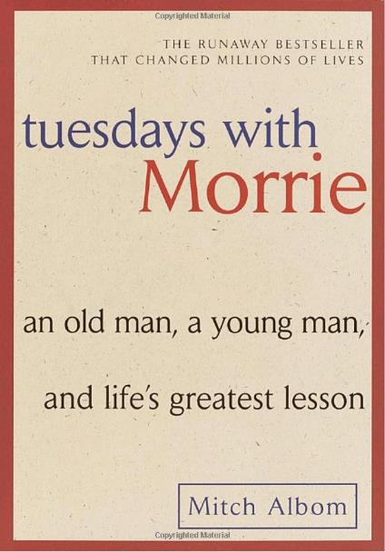
Tuesdays with Morrie

Slide 2
Essential Questions
Why do people fear living?
Why do people fear dying?
Why do people fear silence?
How do we live life with a purpose?

Slide 3
‘Age Old’ Question
Who is your hero?
Who helps you see the world as a more profound place and gives you sound advice to help you make your way through it?

Slide 4
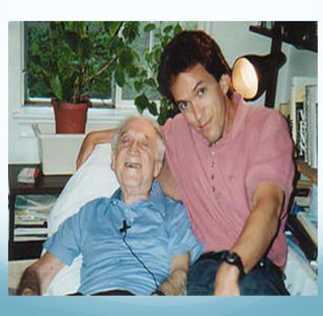
What is this book even about?
Mitch, one of Morrie’s old students promises to keep in touch once he has graduated. However, as time passes and life becomes more complicated, Mitch is unable to keep his promise and soon Morrie becomes a distant character.
One day as Mitch is channel-surfing, he catches the crest of "Nightline." And there's his old teacher and friend Morrie Schwartz telling Ted Koppel he has amyotrophic lateral sclerosis (ALS), also known as Lou Gehrig's disease, and that he's learning how to die.

Slide 5
So why on earth are we reading this?
Here are a couple of reviews:
"Mitch Albom's book is a gift to mankind."
"This book is a MUST read. Buy this book for yourself, then pass it on to a person you love: mother, father, sister, brother, wife, husband, friend or teenager, everyone should read this book."
"A true story of the meaning of life put into 192 pages might seem unimaginable, but Mitch Albom does it all. "
This book has a feel to it, like you were there when Mitch visited Morrie every Tuesday. It really spoke to me in ways that are unimaginable. This is a fantastic book.

Slide 6
As we read keep the following in mind….
How this applies to you life? (Yes, it applies to you)
What are some things that you let fall by the wayside?
Do you have regrets?
What are some thing you would like to change…. But haven't?

Slide 7
Characters
Morrie Schwartz with Mitch Ablom

Slide 8
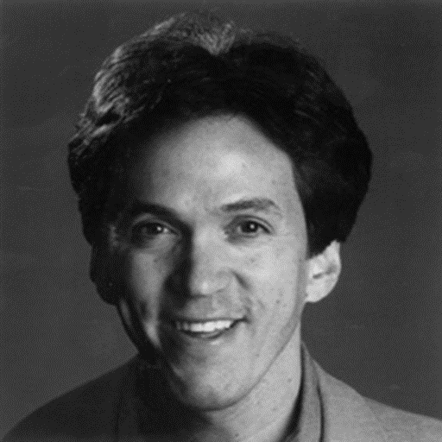
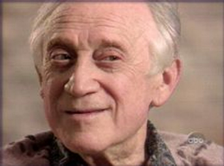
Primary Characters
Mitch Ablom
30-something
Sports writer with a failing career
Graduate of Brandeis University
Wanted to be a musician but gave up the dream
Fast-paced life
Morrie Schwartz
70-something
Former sociology professor
Recently diagnosed with ALS
Insists on living out each day to its fullest

Slide 9
Secondary Characters
Charlotte
Morrie's caring wife
Professor at M.I.T. throughout Morrie's illness
Janine
Mitch's wife
Joins Mitch on a Tuesday visit
Professional singer
Sings for Morrie and makes him cry
Peter
Mitch's younger brother who lives in Spain
Has pancreatic cancer
Refuses any help from his family
Reluctantly allows Mitch to reestablish a relationship with him

Slide 10
Secondary Characters
Ted Koppel
Famous living television interviewer
Conducts three interviews with Morrie for Nightline
Surprised by Morrie’s questioning during interview
Eventually they become fast friends
Morrie deconstructed what he called Koppel’s “narcissistic” TV persona almost moving Koppel to tears during the last interview

Slide 11
Who remembers…

Slide 13
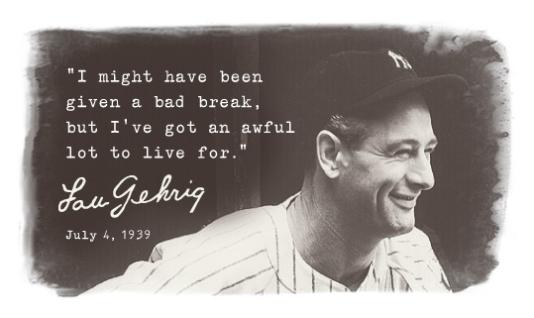
Amyotrophic Lateral Sclerosis (ALS)
Also known as Lou Gehrig’s Disease
Lou Gehrig was a hall-of-fame baseball player, for the New York Yankees, who was diagnosed with ALS in the 1930s.

Slide 14
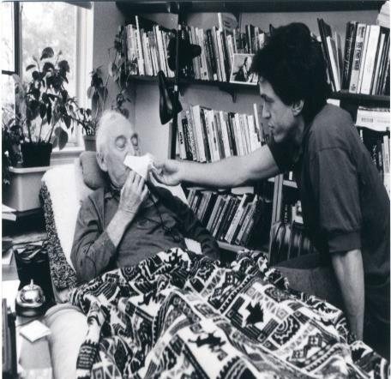
ALS
ALS turns the person's muscles to mush
It generally starts in the extremities (arms and legs) and moves into the body
Patients often die through suffocation as their lungs fail
The greatest tragedy is that the mind stays healthy and functioning

Slide 15
Amyotrophic Lateral Sclerosis (ALS)
Life with ALS
50% live at least 3 years after diagnosed
20% live 5 or more years after diagnosed
10% live 10 or more years after diagnosed.
Physically difficult but does NOT affect the mind.
Communication can be difficult because ALS affects the person’s breathing and muscles needed for speech and arm movement.

Slide 16
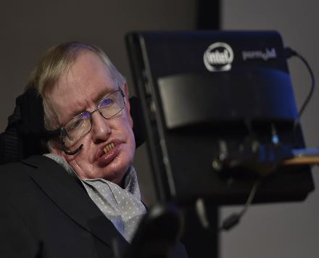
Amyotrophic Lateral Sclerosis (ALS)
Stephen Hawking
Lived with ALS for about 40 years
Diagnosed at the age of 21
Famous Physicist, who furthered our understanding of the universe
wrote A Brief History of Time
Wheelchair bound for 20+ years.
Only able to move a few fingers and uses a voice synthesizer and special computer to speak and write.

Slide 17
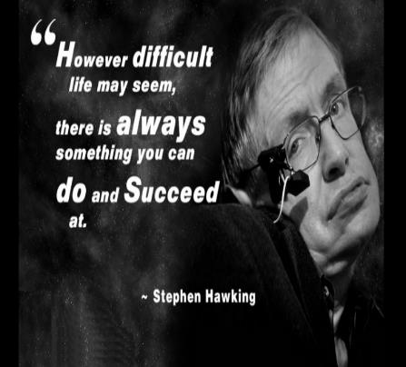
Amyotrophic Lateral Sclerosis (ALS)
“[ALS] has not prevented me from having a very attractive family, and being successful in my work… I have been lucky that my condition has progressed more slowly than is often. But it shows that one need not lose hope.” Stephen Hawking

Slide 18
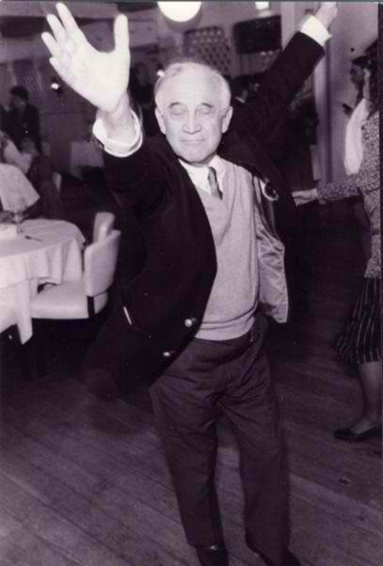
Important Literary Terms

Slide 19
Aphorism
Definition: a short statement, sometimes humorous, that attempts to state a general principle about human behavior.
Example: “Dream as if you'll live forever. Live as if you'll die tomorrow.”
- James Dean

Slide 20
Flashback
Definition: a scene that interrupts the ongoing action in a story to show an event that happened earlier.
Example:

Slide 21
Foreshadowing
When the author gives the reader clues or hints about what is going to happen.

Slide 22
Imagery
Definition: descriptive words and phrases that re-create sensory experiences for the reader.

Slide 23
Theme: The Rejection of Popular Cultural Mores in Favor of Self created Values
Each of Morrie's lessons contributes to a larger, all encompassing message that each individual, Mitch especially, should reject popular cultural values, and instead develop his own.

Slide 24
Theme: Love Or Perish
References to W.H. Auden quote, Morrie’s favorite
Love is the essence of every person, and every relationship, and that to live without it, as Auden says, is to live with nothing.
Love brings meaning to experience, and that without it, one may as well be dead.

Slide 25
Theme: Acceptance Through Detachment
In his quest to accept his impending death, Morrie consciously "detaches himself from the experience" when suffering becomes too much
Morrie does not intend to stop feeling or experiencing in his detachment
He detaches so that he may accept the impermanence of his life and embrace his death, which he knows may come at any moment.

Slide 26
Symbols
Pink hibiscus plant
As Morrie's body deteriorates, so does the condition of the hibiscus plant.
Used as a metaphor for Morrie's life and for life itself
Represents the natural life cycle, which inevitably ends in death
Waves on the ocean
Metaphor compares Morrie’s life to a small wave crashing onto the shore
Morrie is comforted that he will soon return to something larger in the afterlife
Morrie's bed
Morrie's aphorism, "When you're in bed, you're dead," eventually comes true
Used as a symbol of surrender and death

Slide 27
How do you feel about the following topics?
*At the end of the book we will go back to these same topics and you will once again be asked to reflect on each to see if there has been any change.
The World and its values
Feeling sorry for yourself
Regrets
Death
Fear
Aging
Greed
Marriage
Family
Society
Forgiveness
A meaningful life

Slide 28
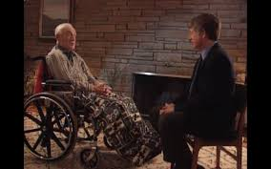
Morrie Schwartz: Lessons on Living, Ted Koppel Nightline Interview

